Slide 1
Image Processing & Computer Vision
Differences between Scalar, Vector, Matrix

Slide 2
Scalars
A scalar is a number
e.g. 3, -5, 0.368, etc
Distance, temperature, mass, length, area are all scalars.

Slide 3
Vectors
A vector is a list of numbers (can be in a row or column). Programmatically this is an array.
(4,6,7) or (4,
6,
7)
e.g. Force is a vector!

Slide 4
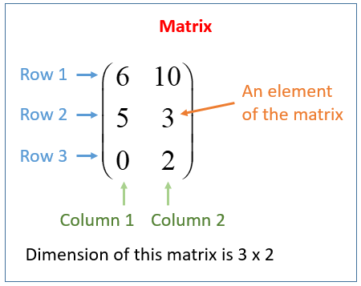
Matrices
A matrix is an array of numbers (one or more rows, one or more columns).

Slide 5
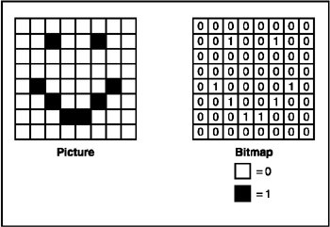
Matrices
A matrix can be used to represent an image!
Remember previous lecture?

Slide 6
Questions
?

